Slide 1

SENIOR AMERICAN AGENCY
Medicareplanchoice.com
Medicare Supplement Policies
800-332-7557 8AM – 3PM EST
dan@senioramericanins.com

Slide 2
MEDICARE SUPPLEMENT PLANS
EXPLORING THE REALM OF MEDICARE SUPPLEMENT OR MEDIGAP POLICIES
THROUGH SENIOR AMERICAN AGENCY

Slide 3
THE TWO WAYS YOU CAN HAVE MEDICARE
ORIGINAL MEDICARE
MEDICARE ADVANTAGE (PART C)
MEDICARE DOES ADMINISTRATION
MANY PEOPLE WILL HAVE ANOTHER POLICY TO PAY WITH MEDICARE
MOST PEOPLE WILL HAVE A SEPARATE PART D RX PLAN
NO NETWORKS, SEE ANY DR
VERY COMPREHENSIVE COVERAGE
PRIVATE COMPANIES ADMINISTRATE
MANY HAVE PROVIDER NETWORKS WITH CERTAIN DR RESTRICTIONS
MOST HAVE COPAYS THAT CAN ADD UP
MOST INCLUDE PART D

Slide 4
YOU CAN KNOW FOR SURE THAT ALL OF YOUR BIG BILLS WILL BE PAID FULLY BY MEDICARE AND A SUPPLEMENT. WITH A MEDICARE ADVANTAGE PLAN THAT MIGHT NOT BE THE CASE
YOUR COSTS WITH MEDICARE A&B
AND SUPPLEMENT*
YOUR COSTS WITH MEDICARE ADVANTAGE
HOSPITAL COPAY ZERO
SKILLED NURSING STAY ZERO
OUTPATIENT SURG. ZERO*
MEDICAL EQUIPMENT ZERO*
AMBULANCE ZERO*
CHEMO THERAPY ZERO*
RADIATION ZERO*
HOSPITAL CO-PAY ?
SKILLED NURSING ?
OUTPATIENT SURGERY ?
MEDICAL EQUIP ?
AMBULANCE ?
CHEMO THERAPY ?
RADIATION ?

Slide 5
WHY MEDICARE SUPPLEMENT?
GET A VERY COMPREHENSIVE HEALTH POLICY
HELPS YOU BUDGET YOUR HEALTH CARE EXPENSES SO YOU KNOW YOUR MONTHLY AND ANNUAL COSTS
GO TO ANY DOCTOR OR HOSPITAL IN THE COUNTRY
NO NETWORKS, REFERRALS, OR PRE-AUTHORIZATIONS
GUARANTEED RENEWABLE AS LONG AS YOU PAY YOUR PREMIUM

Slide 6
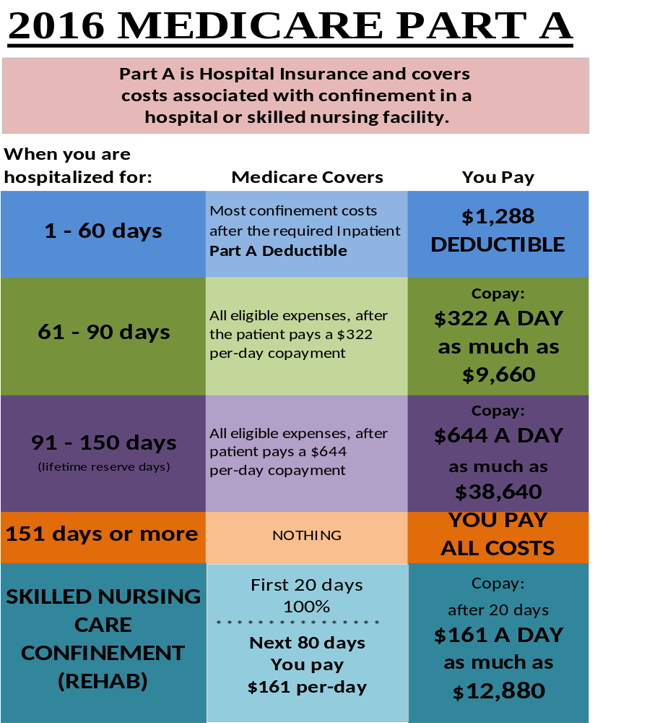
WHAT A MEDICARE
SUPPLEMENT CAN COVER
PART A
DEDUCTIBLE
BASIC
BENEFITS
SKILLED
NURSING
BENEFIT

Slide 7
MEDICARE PART B
TYPE OF SERVICE | MEDICARE PAYS | YOU PAY EACH SERVICE | YOU PAY ANNUALLY
MEDICAL EXPENSE OUTPATIENT HOSPITAL SERVICES | 80% OF THE APPROVED AMOUNT | 20% OF THE APPROVED AMOUNT | $166 (FOR 2016)
CLINICAL LAB SERVICE | 100% | NOTHING
BLOOD | AFTER FIRST 3 PINTS | FIRST 3 PINTS

Slide 8
10 STANDARD MEDICARE SUPPLEMENT PLANS
A | B | C | D | F | G | K | L | M | N
BASIC BENEFITS | BASIC BENEFITS | BASIC BENEFITS | BASIC BENEFITS | BASIC BENEFITS | BASIC BENEFITS | BASIC BENEFITS * | BASIC BENEFITS * | BASIC BENEFITS * | BASIC BENEFITS *
 | PART A DEDUC-TIBLE | PART A DEDUC-TIBLE | PART A DEDUC-TIBLE | PART A DEDUC-TIBLE | PART A DEDUC-TIBLE | PART A DEDUC-TIBLE* | PART A DEDUC-TIBLE* | PART A DEDUC-TIBLE* | PART A DEDUC-TIBLE
 |  | SKILLED NURSING CO-INSURANCE | SKILLED NURSING CO-INSURANCE | SKILLED NURSING CO-INSURANCE | SKILLED NURSING CO-INSURANCE | SKILLED NURSING CO-INSURANCE* | SKILLED NURSING CO-INSURANCE* | SKILLED NURSING CO-INSURANCE* | SKILLED NURSING CO-INSURANCE
 |  | PART B DEDUC-TIBLE |  | PART B DEDUC-TIBLE
 |  |  |  | PART B EXCESS CHARGES | PART B EXCESS CHARGES
 |  | FOREIGN TRAVEL | FOREIGN TRAVEL | FOREIGN TRAVEL | FOREIGN TRAVEL |  |  | FOREIGN TRAVEL | FOREIGN TRAVEL
 |  |  |  |  |  | OUT OF POCKET MAX $4,260 | OUT OF POCKET MAX $2,310

Slide 9
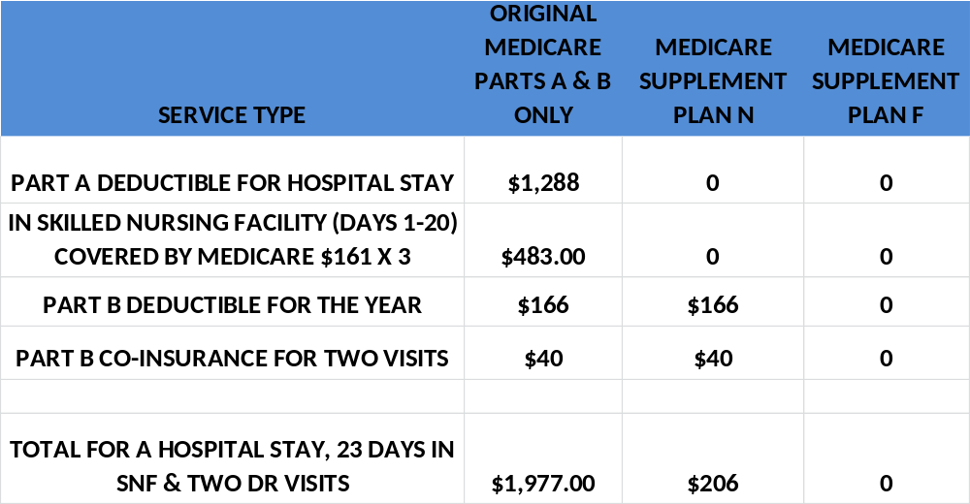

Slide 10
THINGS TO REMEMBER
PEOPLE ENTERING MEDICARE FOR THE FIRST TIME ARE GUARANTEED ISSUE
NO MEDICAL QUESTIONS ARE ASKED
ALL HEALTH CONDITIONS ARE COVERED
NO PRE-EXISTING CONDITION LIMITATIONS
POLICIES ARE GUARANTEED RENEWABLE FOR LIFE
COMPETITIVE PRICING FOR NEW MEDICARE MEMBERS

Slide 11
THE NEXT STEP
WE CAN HELP
WE HAVE INCLUDED A QUOTE ON MEDICARE SUPPLEMENT WITH THIS VIDEO
FILL OUT THE APPLICATION AND MAIL BACK IN THE RETURN ENVELOPE
Medicareplanchoice.com – CLICK ON GET A QUOTE OR WEB CHAT AND FOLLOW INSTRUCTIONS
TELEPHONE SUPPORT 800-332-7557 8AM -3PM EST
GET A QUOTE BY EMAIL – SEND REQUEST TO: dan@senioramericanins.com

